Slide 1
Deep Learning
6. Neural Networks Applications in
Computer Vision

Slide 2
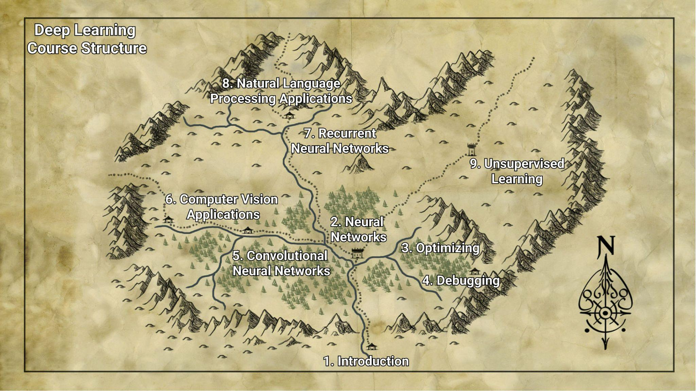

Slide 3
RECAP

Slide 4
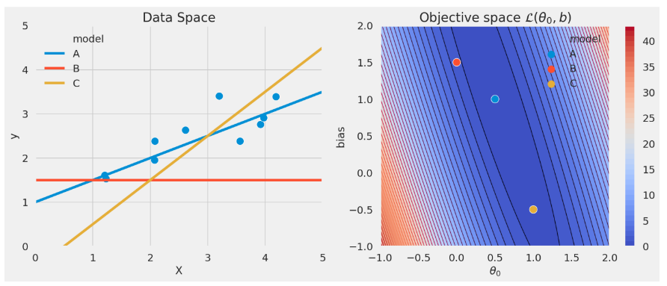
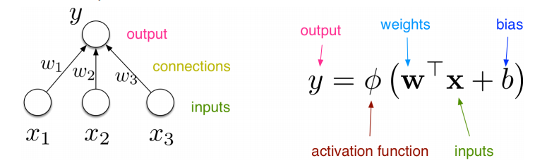
Recap

Slide 5
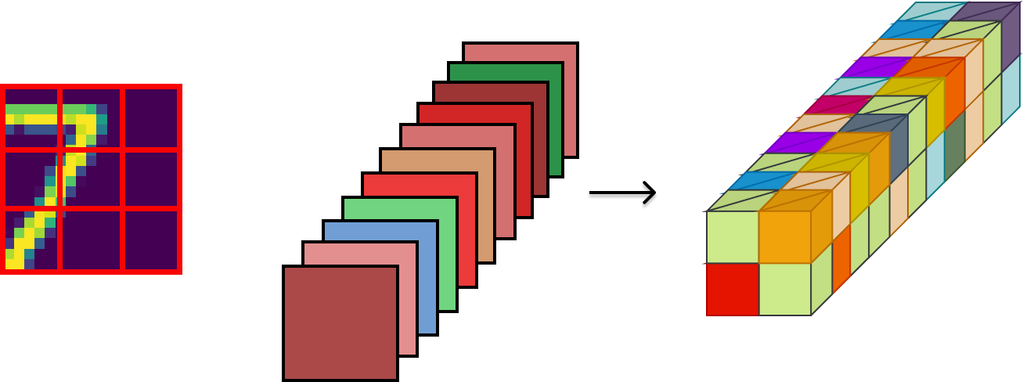
Recap: Convolutional Networks
A convolutional operation:
Output feature map
Input
Kernels

Slide 6
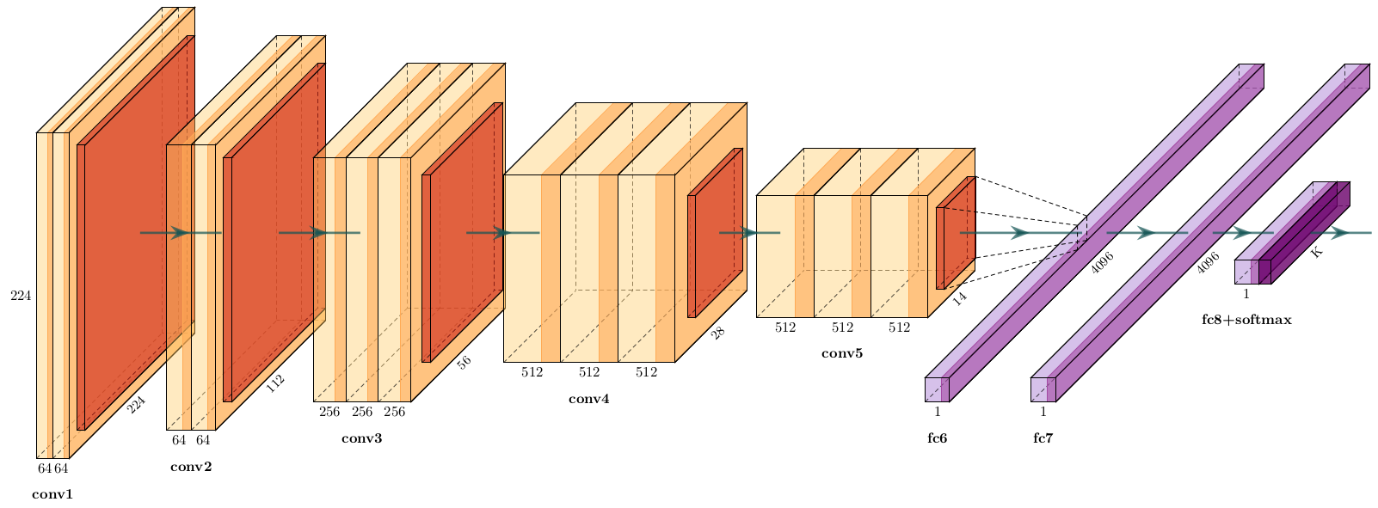
Recap: Convolutional Networks
Simonyan and Zisserman [2014]: Very deep convolutional networks for large-scale image recognition.
Image from: https://github.com/HarisIqbal88/PlotNeuralNet

Slide 7
Recap: Improve learning on a new task
Transfer learning
Reuse parts of a previously learned model
Self-supervised learning
Learn good representation without using annotations
Rely on self-supervision: tasks defined purely from data
You can transfer the self-supervised representation to a desired task

Slide 8
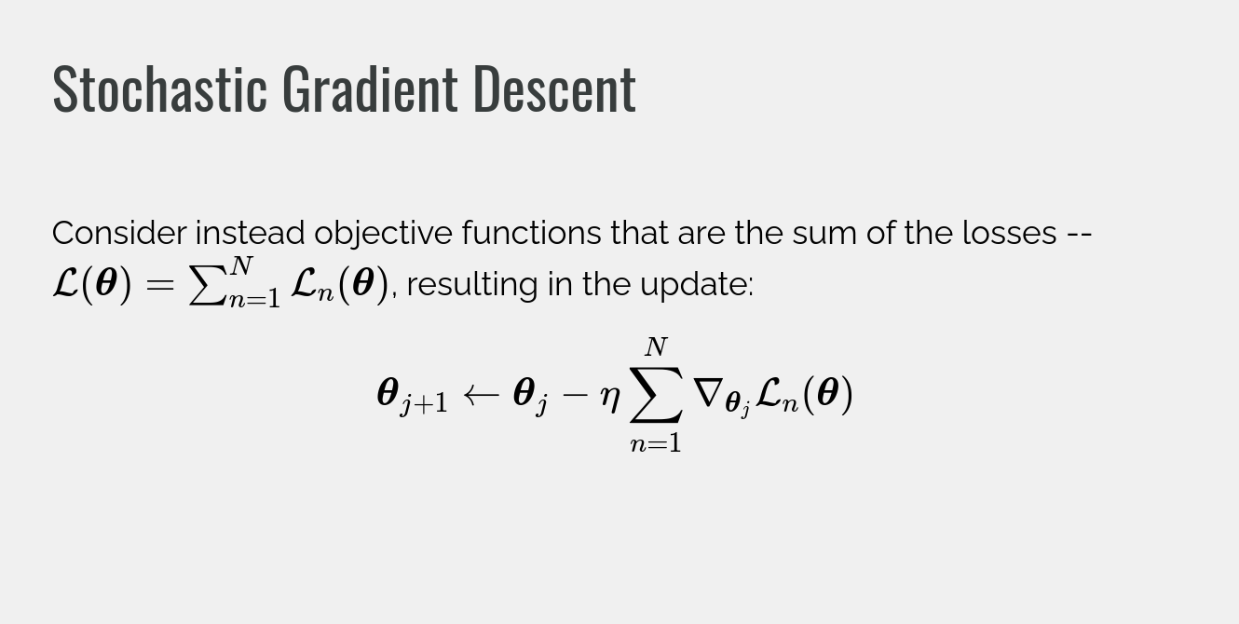

Slide 9
BIAS and SPURIOUS features

Slide 10
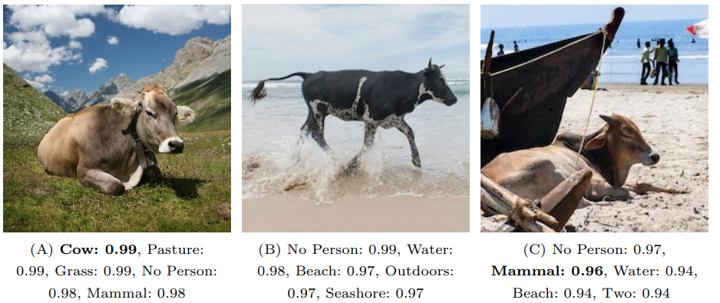
Shortcuts in Learning
Shortcuts: learning strategies / rules that solve the task in an unintended way that is not based on true causes and cannot generalize
Beery et al. "Recognition in terra incognita." ECCV. 2018. Geirhos et al. "Shortcut learning in deep neural networks." Nature Machine Intelligence (2020).
These schotcuts are based on spurious (fake / misleading) features
Also called non-causal features
e.g. Use color of the background to distinguish between cows and camels

Slide 11
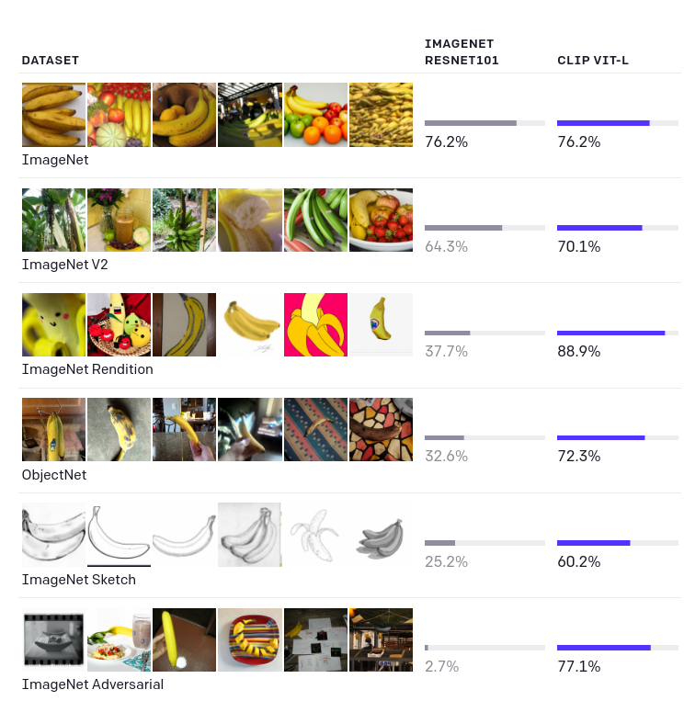
Shortcuts in Learning
Large scale models like OpenAI’s CLIP trained on 400M image-text pairs are:
more robust to shortcuts
capable of better generalising

Slide 12
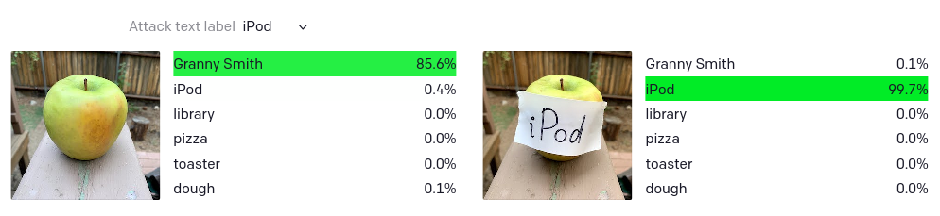
Shortcuts in Learning
https://openai.com/blog/multimodal-neurons/
But even CLIP models are still vulnerable to shortcuts

Slide 13
Systematic generalisation
Systematic Generalization: Generalization to examples that may not be drawn from the same distribution as the training data, but that obey the same basic rules of production or underlying structure.
Systematic generalisation - special king of out-of-distribution generalisation
Promoting systematic generalisation :
Increase data diversity and potential use data augmentations
Learn features that are do not change across different environments
They are more robust - and ideally represent the true causes
Modularity and other Inductive biases

Slide 14
Case study: face analysis
Buolamwini and Gebru [2018] study the performance of standard gender classifiers offered by API bundles by Microsoft, IBM and Face++
They show large differences in the performance on different subgroups
All classifiers perform better on male faces than female faces
8.1% − 20.6% difference in error rate
All classifiers perform better on lighter faces than darker faces
11.8% − 19.2% difference in error rate
All classifiers perform worst on darker female faces
20.8% − 34.7% error rate
Buolamwini and Gebru. "Gender shades: Intersectional accuracy disparities in commercial gender classification." FAccT 2018.
Notes:
Urbina, Fabio, et al. "Dual use of artificial-intelligence-powered drug discovery." Nature Machine Intelligence (2022): 1-3.

Slide 15
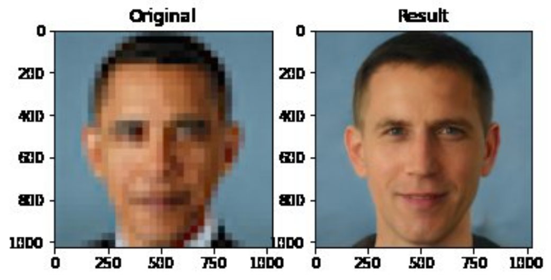
Case study: Super-Resolution
Current ML methods could upsample low resolution images
Keep in mind that some information cannot be recuperated from low-resolution
ML methods inherently ‘guess’ the missing details
In certain cases this could be useful: photo sharing - video games
But this can also be used for dangerous applications - wrongly identifying suspects
Notes:
https://twitter.com/Chicken3gg/status/1274314622447820801

Slide 16
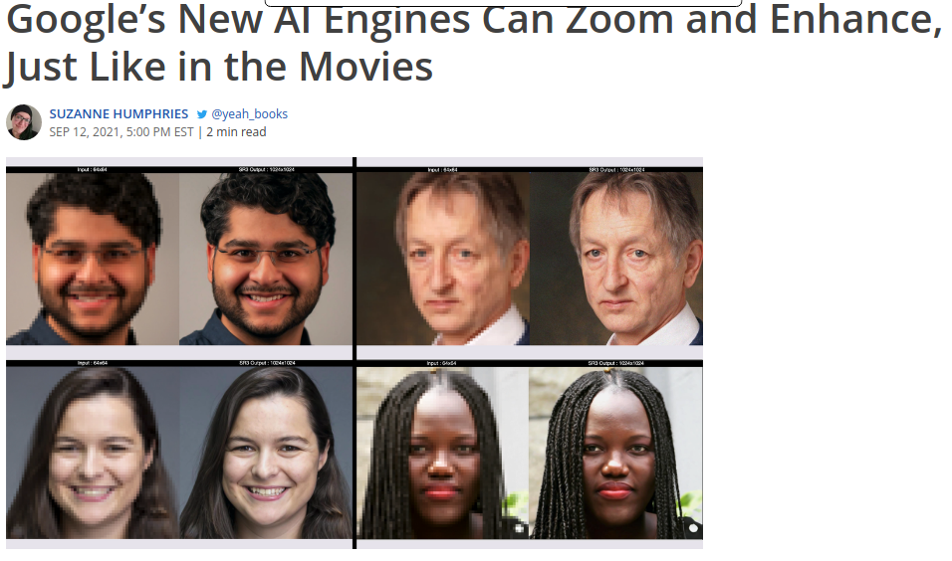
Case study: Super-Resolution
FALSE
Always present clearly what a method can do and cannot do
Discuss unintended use cases
Notes:
https://twitter.com/Chicken3gg/status/1274314622447820801

Slide 17
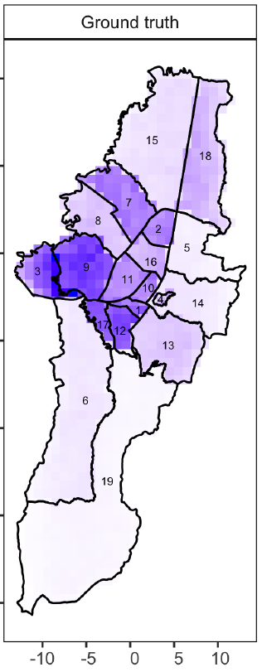
Case study: predictive policing
Does this seem like a problem approachable with ML?
Could spatio-temporal models for weather prediction or car-sharing prediction be used?
When applied in real work these methods create feedback loops that increase the biases.
Should we use them in the first place?
Notes:
Akpinar et. al. "The effect of differential victim crime reporting on predictive policing systems." FAccT 2021

Slide 18
Case study: hiring and job searching
Workflow of LinkedIn Talent Search (tool used by recruitos)
Retrieve large set of candidates based on rules
Rank candidates based on scores given by ML models
Some care for re-ranking based on given protected attributes
Gender and age of the top results should reflect a desired distribution
The method obtains: “tremendous improvement in the fairness metrics”
But how about attributes that are not considered?
It is hard to define all possible protected attributes (ethnic group, place of birth, address, etc. )
Some biases are hidden and cannot be easily defined
How can we be sure that the ranking is not entirely based on shortcuts?
Geyik et al. "Fairness-aware ranking in search & recommendation systems with application to linkedin talent search." ACM KDD. 2019.

Slide 19
Recap
Deep Learning suffer from learning shortcuts
It is hard to eliminate spurious features
Data has biases
DL systems could produce biassed and unintended results

Slide 20
COMPUTER VISION TASKS

Slide 21
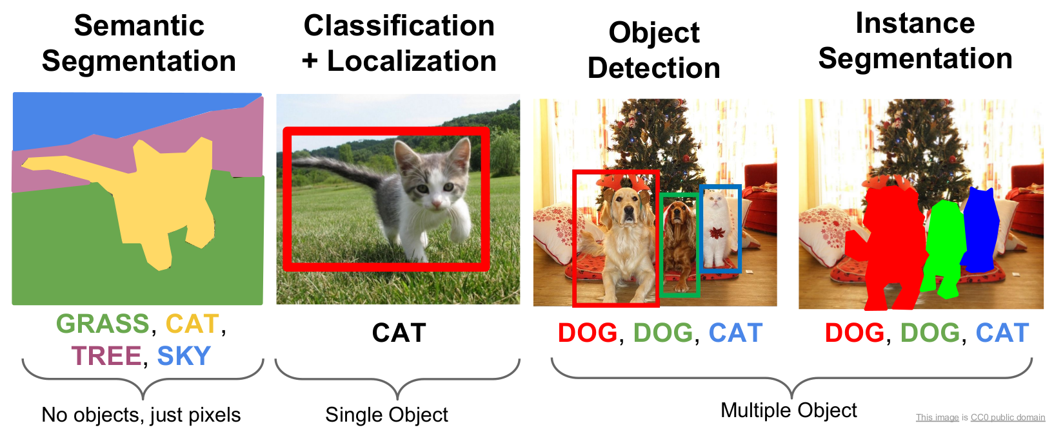
Computer Vision Tasks

Slide 22
SEGMENTATION

Slide 23
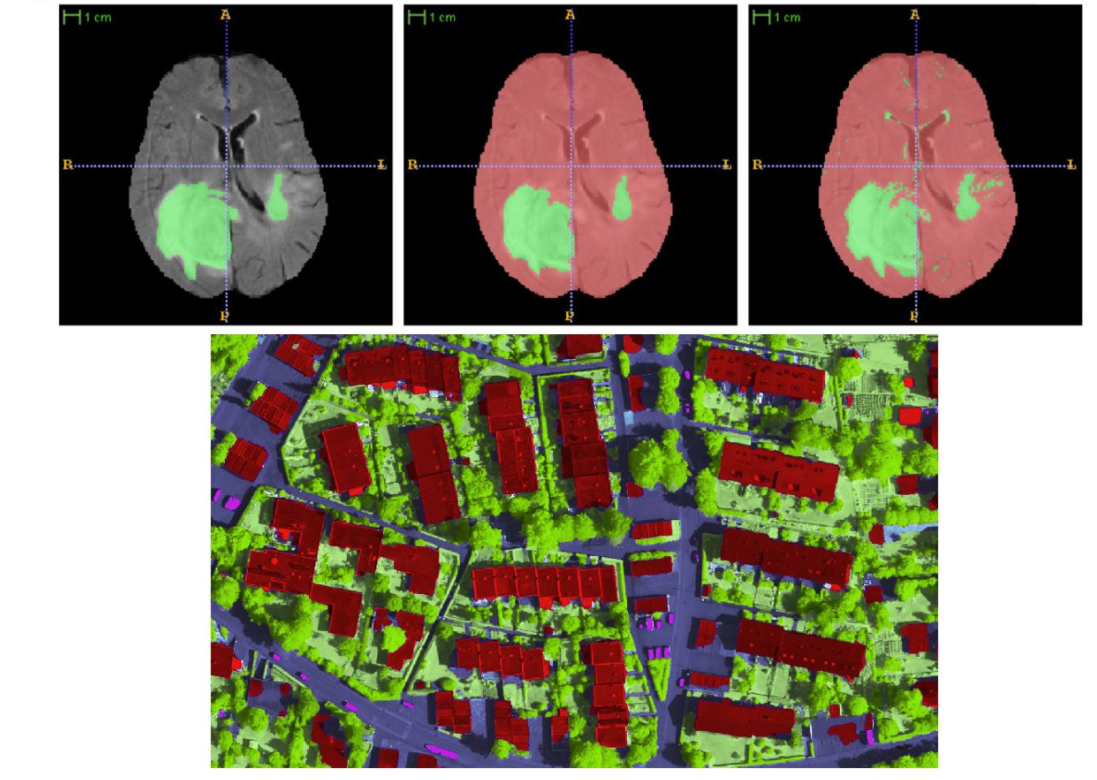
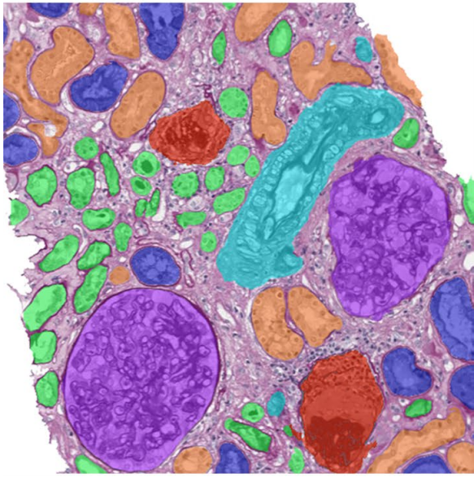
Segmentation
Definition:
partition an image into regions each of which has a reasonably homogeneous visual appearance or which corresponds to objects or parts of an object [Forsyth and Ponce 2003]
Image from: Bauer et al. [2011], Marmanis et al. [2016], van der Laak [2021].
Notes:
See also: van der Laak [2021] Deep learning in histopathology: the path to the clinic. Nature medicine 2021. https://www.nature.com/articles/s41591-021-01343-4.pdf

Slide 24
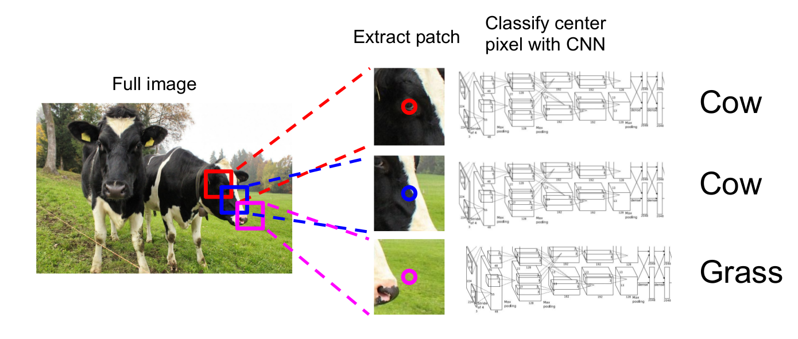
Segmentation: Sliding Window
Slide from: CS231n Stanford Course

Slide 25
Segmentation: Sliding Window
Select patches obtained by sliding a window through the image
Learn to classify each patch as the class of the object or region found at its center
Create (patches, center labels) pairs
Learn the convolutional network to predict the class of the center of a patch
Classify each pixel by selecting a patch around it and run the learnt network
Problem: Inefficient

Slide 26
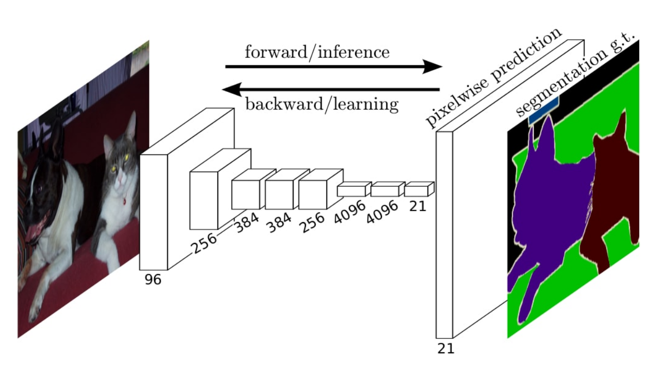
Segmentation
Goal:
Generate a segmentation for the entire image without redundant computations
Use information learned on classification tasks with more data, and be able to transfer it to segmentation task
Image from: Long et al.[2014]: Convolutional networks for semantic segmentation.

Slide 27
Segmentation
Convolution, pooling and activations layers are local operations
apply them on the whole image
A fully-connected layer could be seen as convolutional layer
Instead of fc layers, use conv layers with filters of the same size as the input to the gc

Slide 28
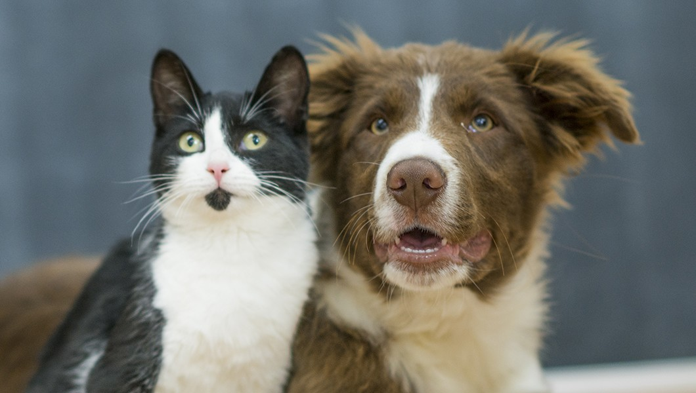
Segmentation - sliding window
Let's take two patches from a larger image and pass each of them through the same convolutional neural network
We will observe that there exist points in the intermediate features maps of the net that:
Are obtained by the exact computations of the exact same input
Are redundant

Slide 29
Segmentation - sliding window
Convolutional and pooling layers share computations
There exists points in the feature maps of the two image patches that have the same receptive field in the input image
These points have the same values obtained by the same computations
Results: for neighbouring patches most convolutional and pooling computations are shared

Slide 30
Segmentation - sliding window
Convolutional and pooling layers share computations
There exists points in the feature maps of the two image patches that have the same receptive field in the input image
These points have the same values obtained by the same computations
Results: for neighbouring patches most convolutional and pooling computations are shared

Slide 31
Segmentation - sliding window
Fully connected layers depend on the whole input
Output of the fully-connected layers for the two images are completely different
Result: the two patches do NOT share any computations in the fully connected layers

Slide 32
Segmentation
Fully connected layers depend on the whole input
Output of the fully-connected layers for the two images are completely different
Result: the two patches do NOT share any computations in the fully connected layers

Slide 33
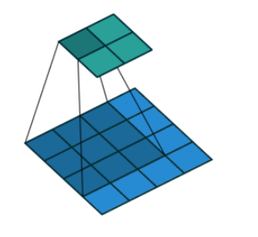
Apply convolutional layer on larger input
convolution, pooling and activations layers are local operations
apply them on the whole image

Slide 34
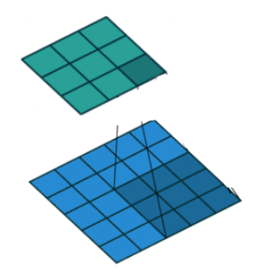
Apply convolutional layer on larger input
convolution, pooling and activations layers are local operations
apply them on the whole image
enlarging the input (blue) does NOT influence the top 4x4 cells of the output

Slide 35
FULLY CONV

Slide 36
Fully-connected -> convolutional
Instead of applying a fully connected layer on the output corresponding to each small patch, we will apply a conv layer on the entire image that would produce the same output
Let’s consider first only the feature maps corresponding to a small patch, that would be fed to a fully connected layer

Slide 37
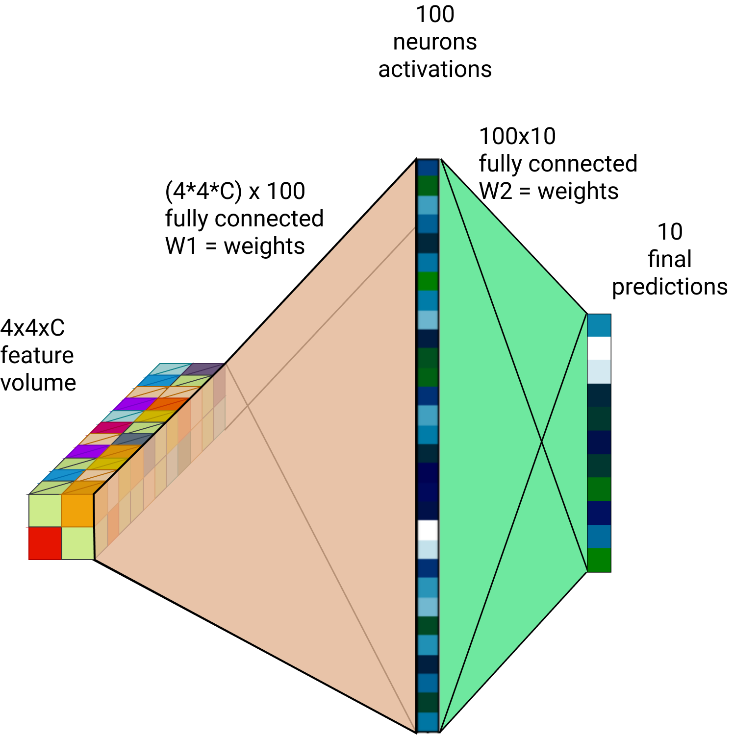
Fully-connected -> convolutional
Input: feature volume of size 4x4xC
Process the features into the final classification by two fully connected layers
fully connected layers can be converted into convolutional layers
Fully connected layer is equivalent with convolutional layer with kernels of the same size as the input

Slide 38
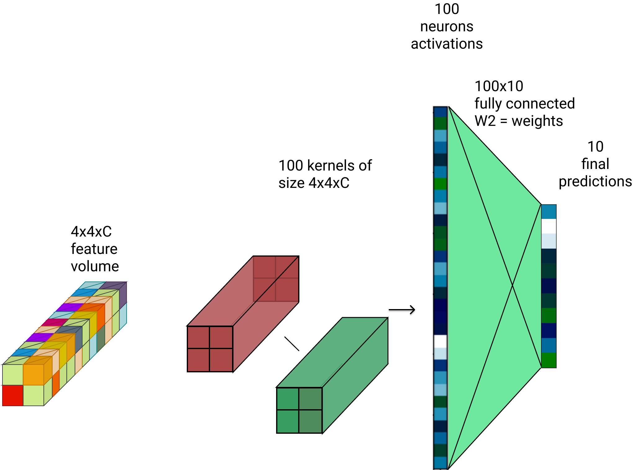
Fully-connected -> convolutional
Use the same parameters from the fully connected but reshape them to be used as convolutional parameters
From (4*4*C)x100 matrix
To 100 kernels of size 4x4xC

Slide 39
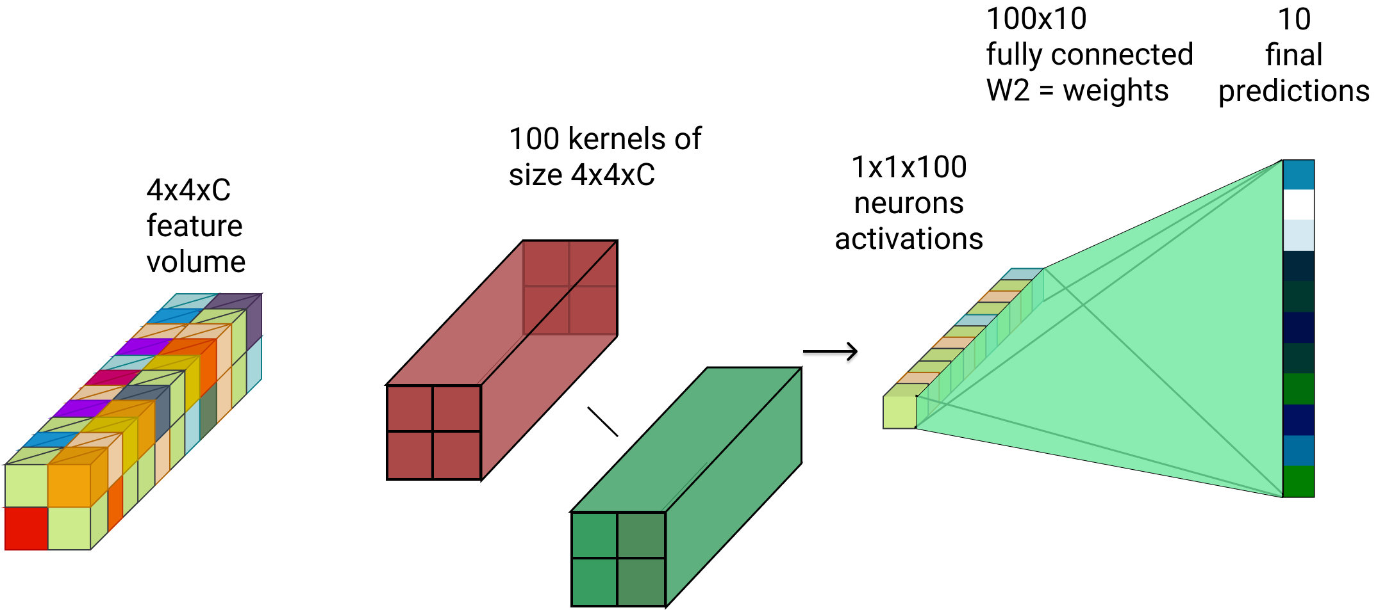
Fully-connected -> convolutional
From a input with 2 spatial dimensions H x W and some channels C we obtain a single vector with 100 channels
Resulting vector can be seen as a single 1x1 spatial location with 100 channels

Slide 40
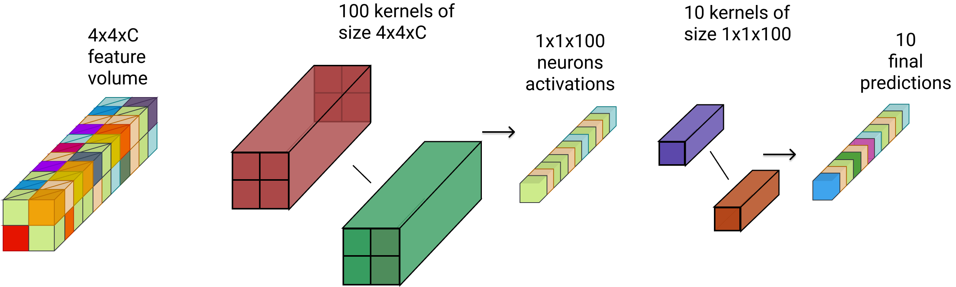
Fully Convolutional Network (FCN)
All fully connected have been replaced by convolutions
This network would work on any input size

Slide 41
Fully Convolutional Network (FCN)
Advantages over fully-connected
Any input size you want
Spatial information is kept
Computational cheaper
You Do not repeat the same operation multiple times

Slide 42
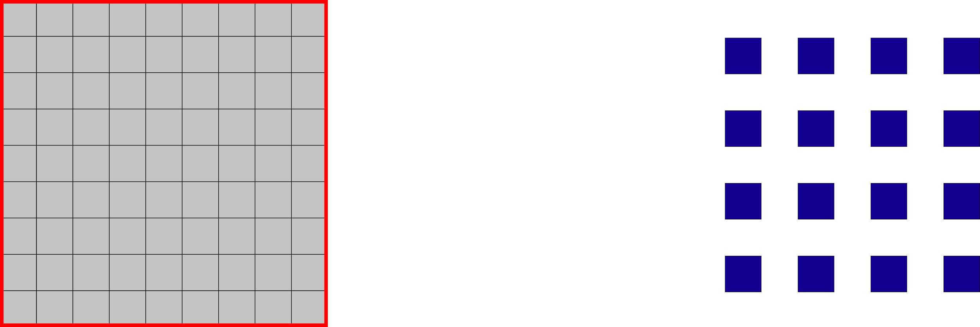
Problem: Sparse Output
Due to the strides the output is sparser than the input
Every stride=k layer makes the output k^2 sparser
For segmentation we want dense output
Every pixel should have a label
Input
Output

Slide 43
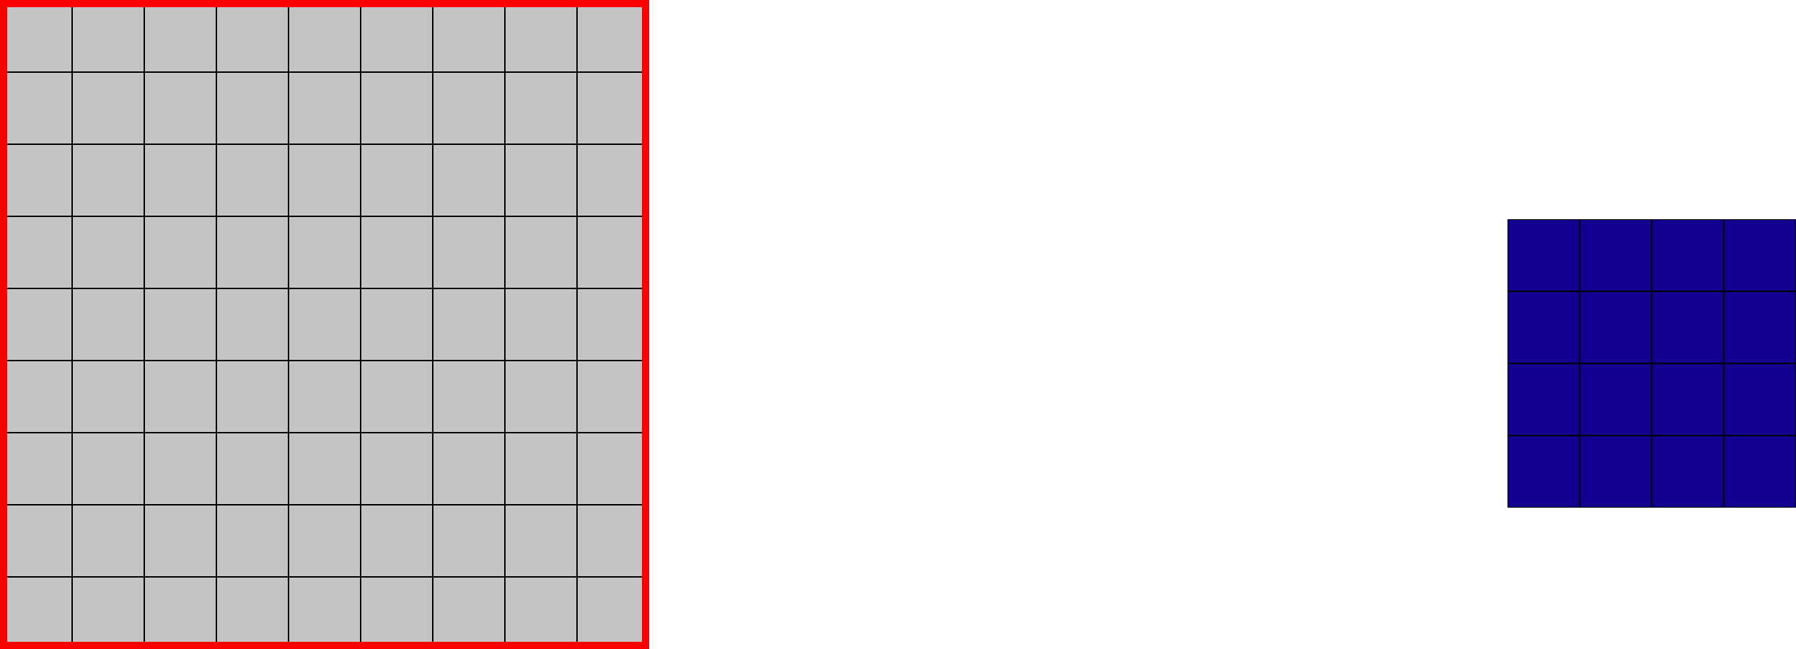
Sparse Output
Solution 1: shift and stitch
Shift the input by 1 pixel and get a different output

Slide 44
Sparse Output
Solution 1: shift and stitch
Shift the input by 1 pixel and get a different output

Slide 45
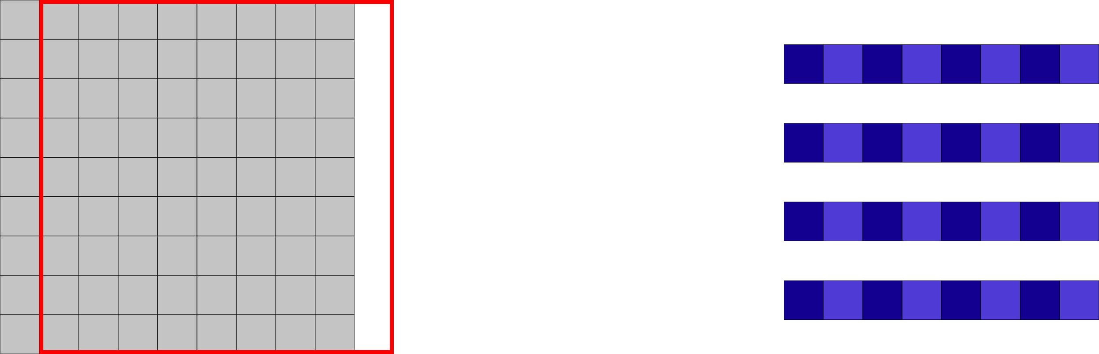
Sparse Output
Solution 1: shift and stitch
Shift the input by 1 pixel and get a different output

Slide 46
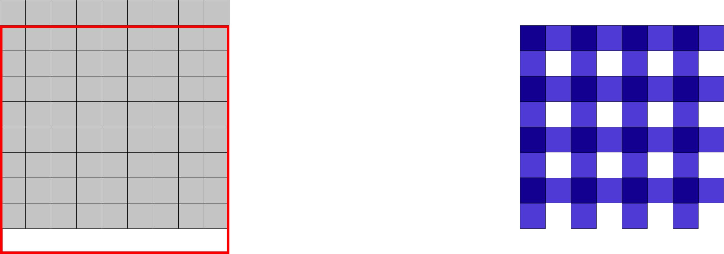
Sparse Output
Solution 1: shift and stitch
Shift the input by 1 pixel and get a different output

Slide 47
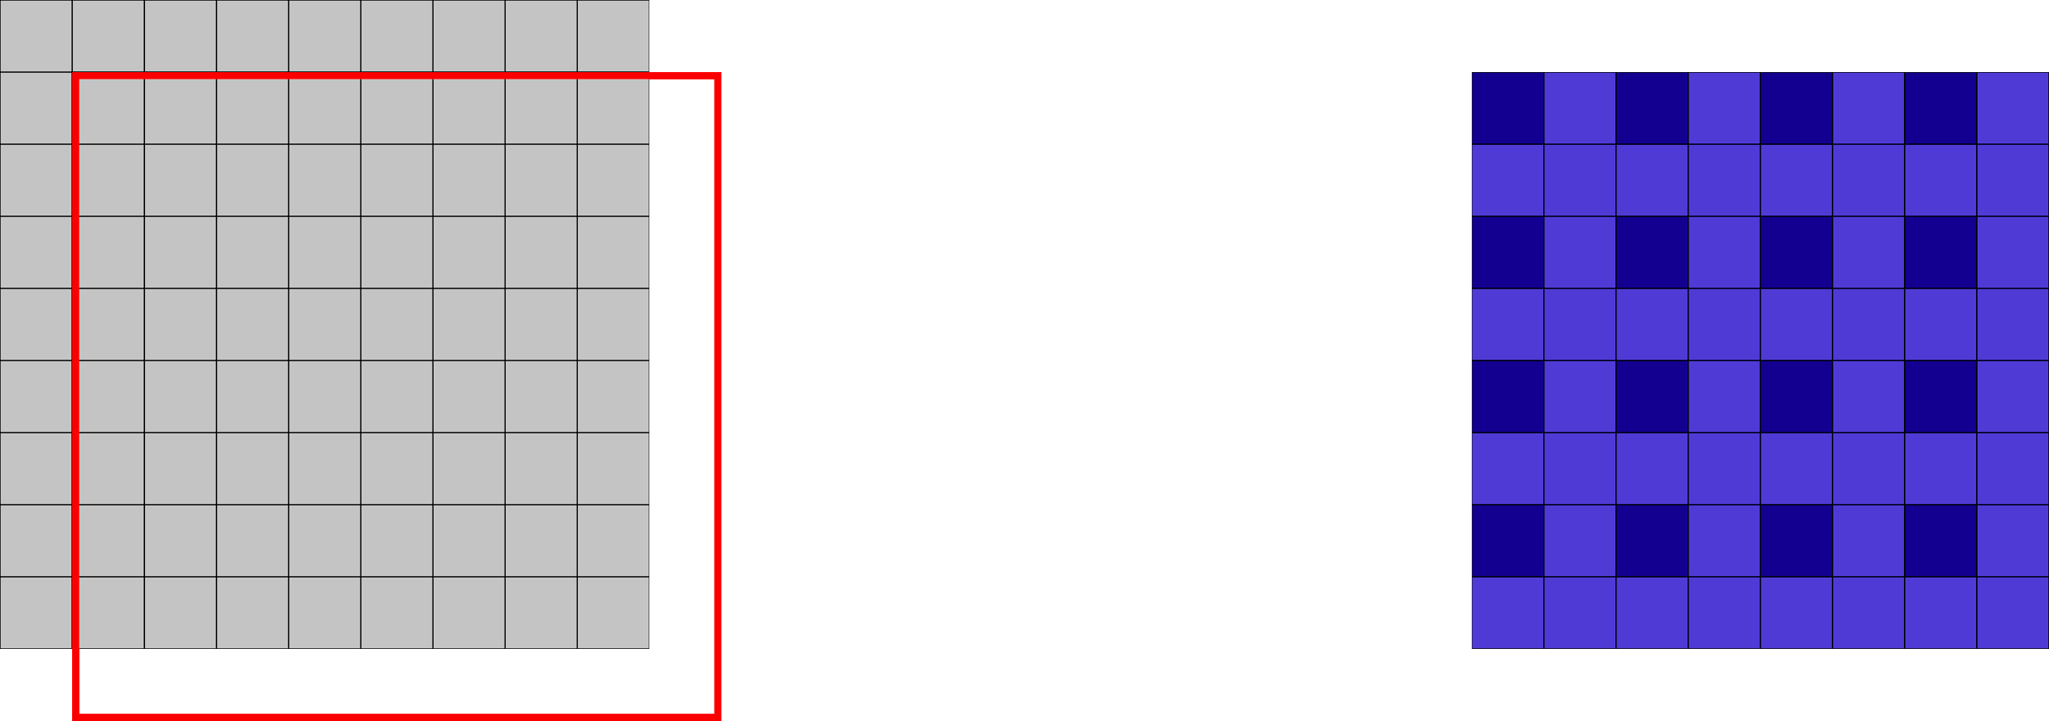
Sparse Output
Solution 1: shift and stitch
Shift the input by 1 pixel and get a different output

Slide 48
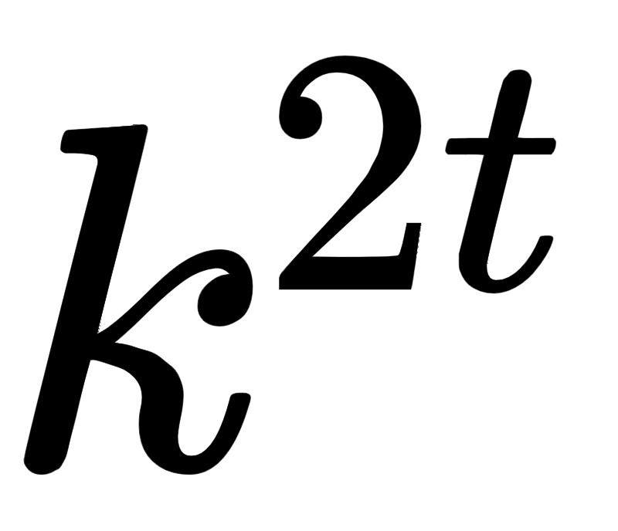
Sparse Output
Solution 1: shift and stitch
Shift the input by 1 pixel and get a different output
Computational intensive: for t layers with stride k => passes

Slide 49
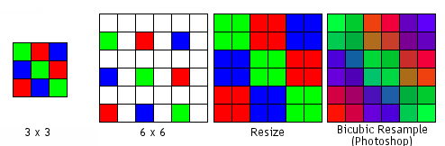
Sparse Output
Solution 2: upsample via interpolation
Pro: Simple and efficient
Con: can not capture complex upscaling
Notes:
http://hobbymaker.narod.ru/English/Articles/resampling_eng.htm

Slide 50
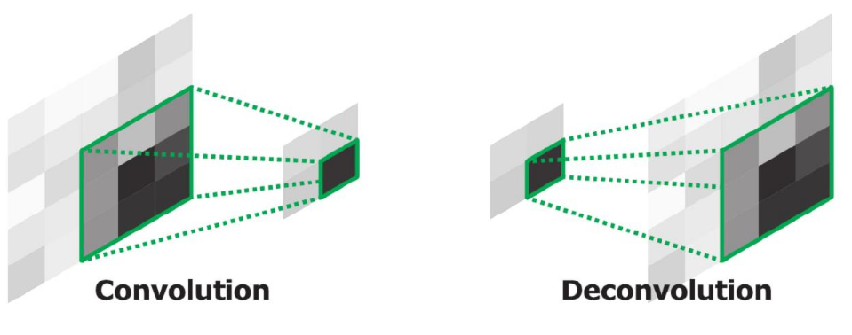
Sparse Output: Deconvolutional Layers
Solution 3: use deconvolutional layer
Name: Deconvolution = Backwards Convolution = Transposed Conv = Fractionally strided Conv
A deconv layer has ‘inverse’ operations as a convolution.
A filter is multiplied with a point in the input and the resulting matrix is added in the corresponding region in the output
Apply stride K in the output: => output is K^2 times larger
Image from: Noh et al. [2015]: Learning deconvolution network for semantic segmentation

Slide 51
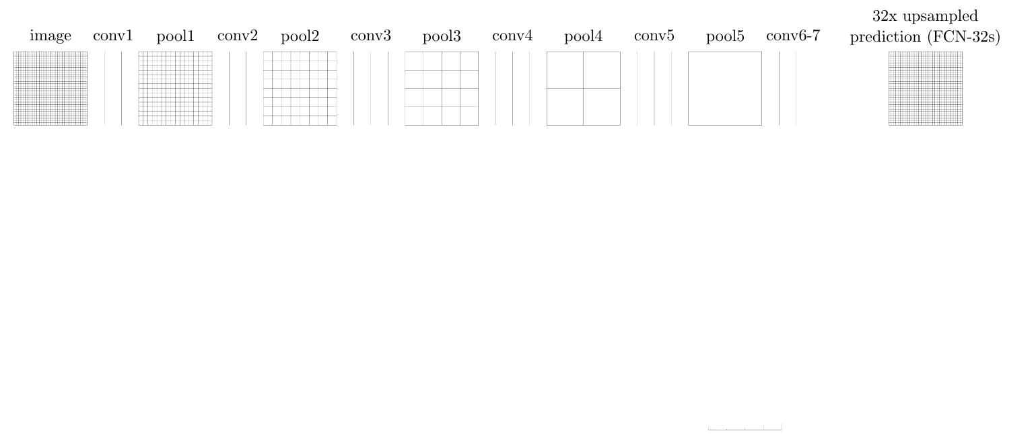
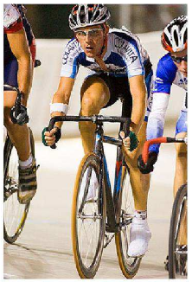
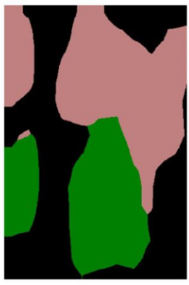
Fully Convolutional Network (FCN)
By converting the fully connected layers into convolutions we have a completely convolutional network that can be applied on images of any size
The segmentation is rough because it results from upsampling a low resolution output
Solution: use information from intermediate layers in the network, where low-level details are present
Long et al.[2014]: Convolutional networks for semantic segmentation.

Slide 52
SKIP LAYERS

Slide 53
Skip Layers
Combine the outputs of an upper and an intermediate layer
Q: Why would low-level features help?
Useful for aligning the output with image boundaries, or with part of objects
Use a 1x1 convolutional layer on features from lower levels to produce class predictions
Upsample and add prediction scores from different levels then do a softmax

Slide 54
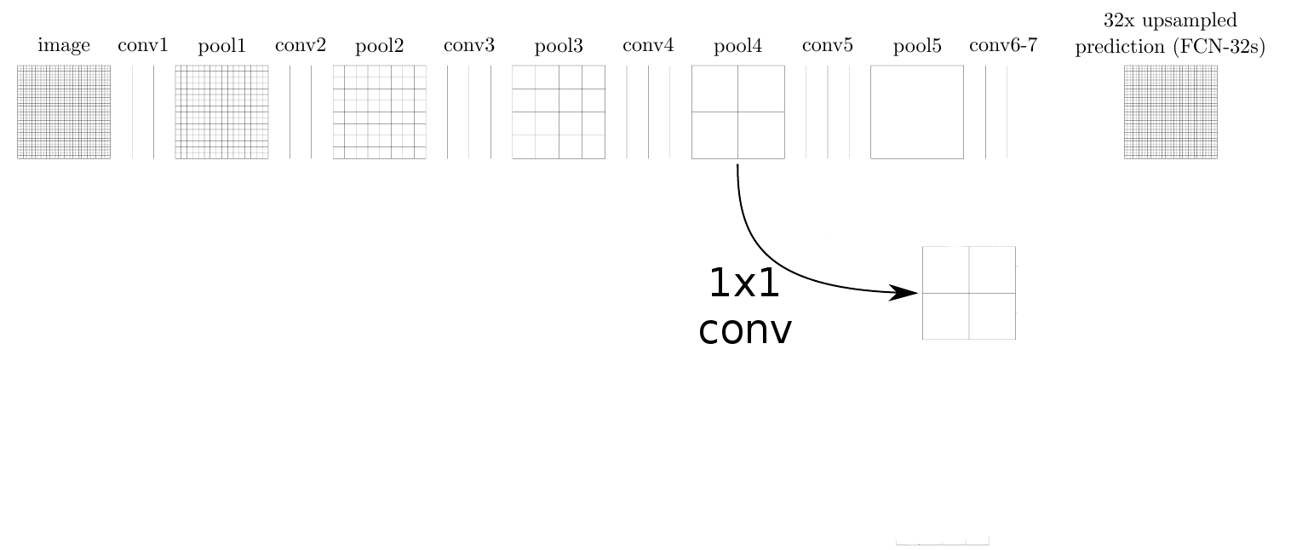
Skip Layers
Combine the outputs of an upper and an intermediate layer
Q: Why would low-level features help?
Useful for aligning the output with image boundaries, or with part of objects
Use a 1x1 convolutional layer on features from lower levels to produce class predictions
Upsample and add prediction scores from different levels then do a softmax

Slide 55
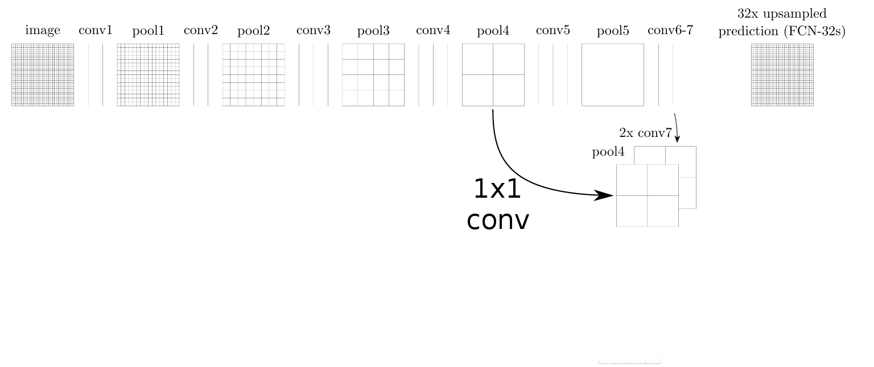
Skip Layers
Combine the outputs of an upper and an intermediate layer
Q: Why would low-level features help?
Useful for aligning the output with image boundaries, or with part of objects
Use a 1x1 convolutional layer on features from lower levels to produce class predictions
Upsample and add prediction scores from different levels then do a softmax

Slide 56
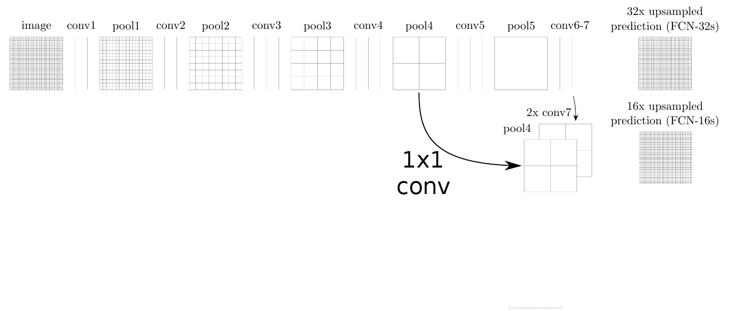
Skip Layers
Combine the outputs of an upper and an intermediate layer
Q: Why would low-level features help?
Useful for aligning the output with image boundaries, or with part of objects
Use a 1x1 convolutional layer on features from lower levels to produce class predictions
Upsample and add prediction scores from different levels then do a softmax

Slide 57
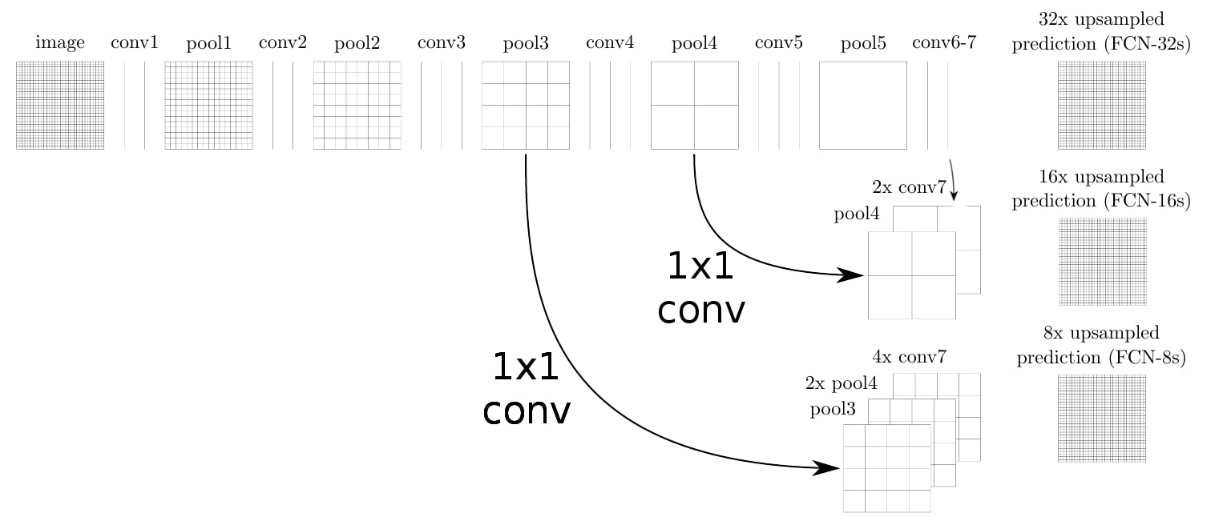
Skip Layers
Combine the outputs of an upper and an intermediate layer
Q: Why would low-level features help?
Useful for aligning the output with image boundaries, or with part of objects
Use a 1x1 convolutional layer on features from lower levels to produce class predictions
Upsample and add prediction scores from different levels then do a softmax

Slide 58
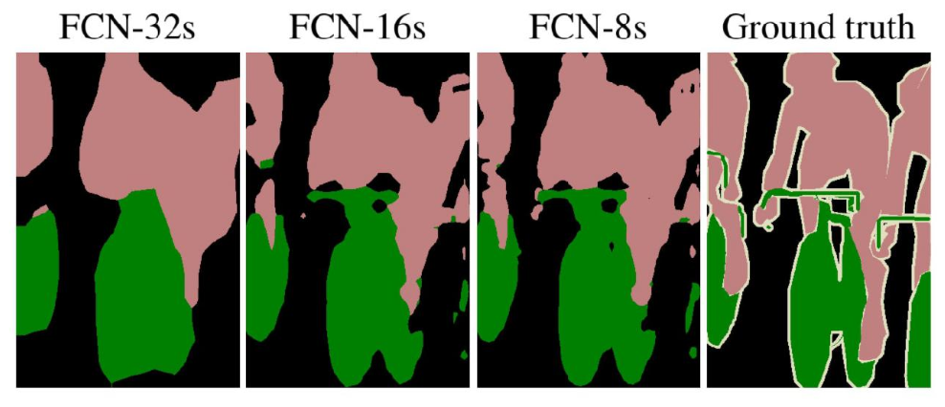
Results
Using lower level features improves the level of details (resolution) of the output

Slide 59
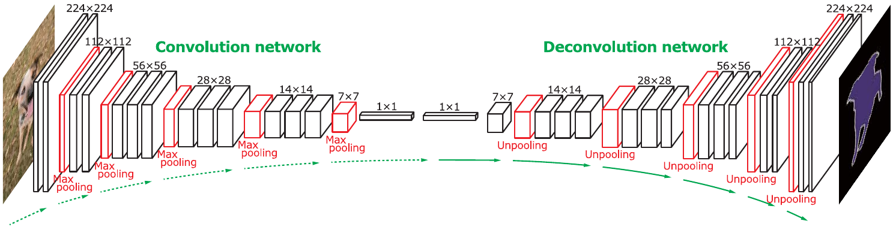
Deconvolutional Network
Use deconvolutions to sample features maps
not just the final segmentation map
Use an upsampling deconvolutional part that ‘mirrors’ the convolutional part
Noh et al. [2015]: Learning deconvolution network for semantic segmentation

Slide 60
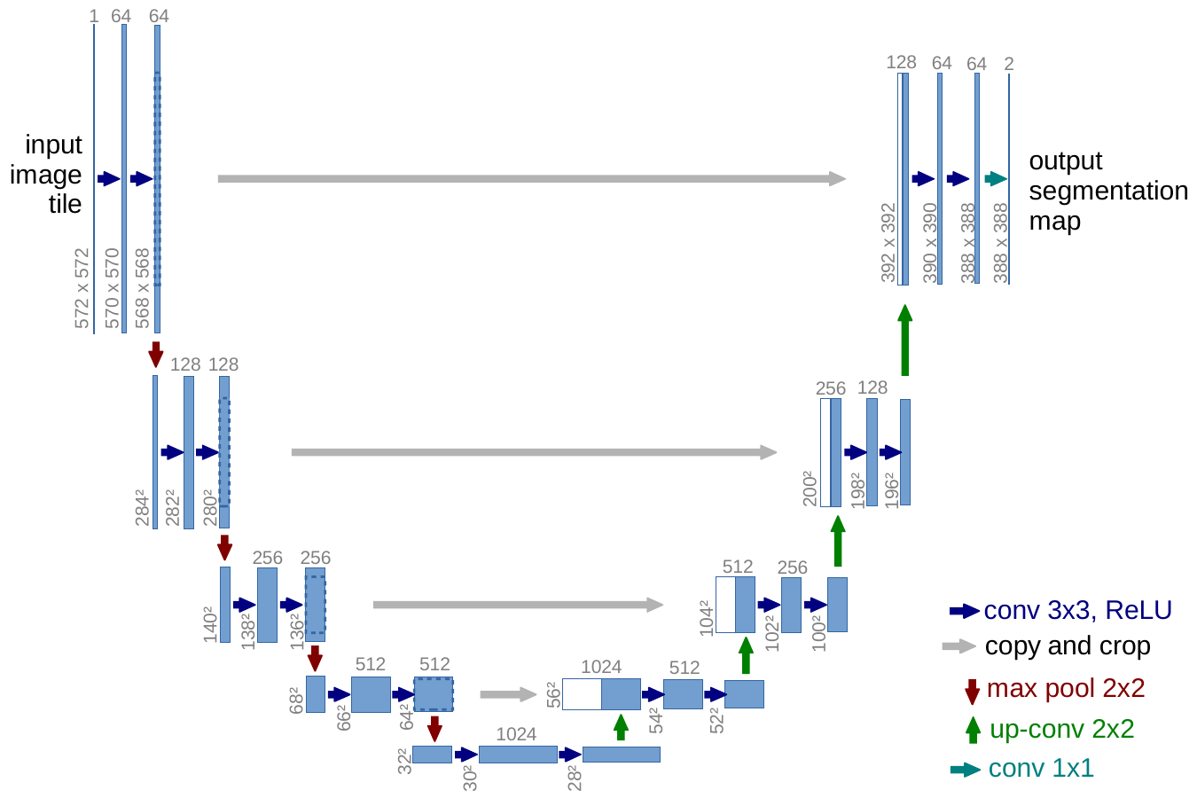
U-net: using (again) intermediate features
The contractive, convolutional part extracts information about the object
Expansive part has the role of inferring the exact segmentation shape
Upscale the convolutional maps in multiple layers
The middle convolutional features are highly semantic but have low resolution - poor localisation
Use previous convolutional features for fine-grained spatial information
Ronneberger [2015]: U-net: Convolutional networks for biomedical image segmentation

Slide 61
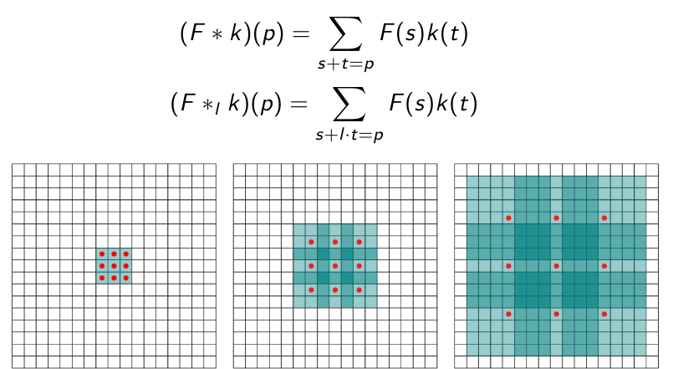
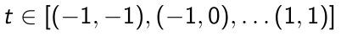
Extra: Dilated Convolutions
Operation designed for dense prediction
Used in networks without downsample layers (pooling, strided convs)
Aggregate distant (contextual) information without losing input resolution
Normal Conv:
Dilated Conv:
l - dilation factor

Slide 62
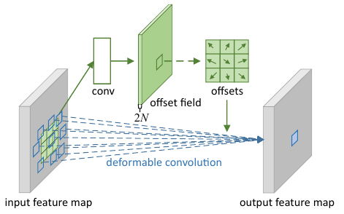
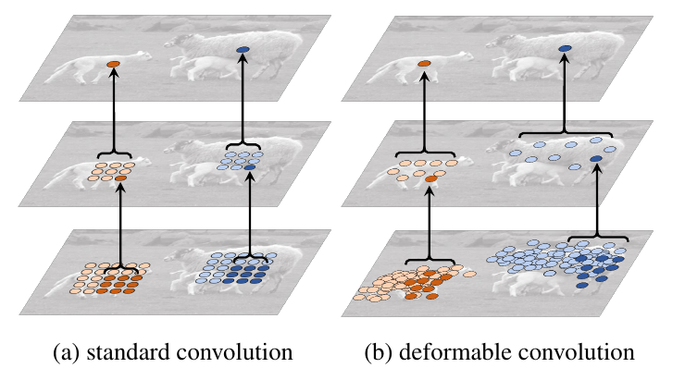
Extra: Deformable Convolutions
Learn to predict an offset for every point in the kernel

Slide 63
OPTICAL FLOW

Slide 64
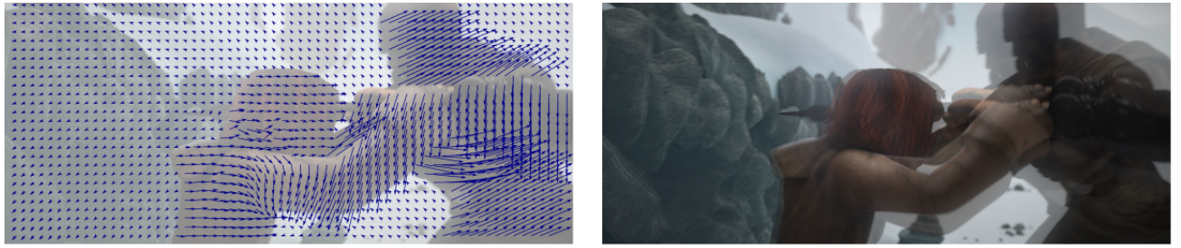
Optical Flow
Given 2 frames from a video, how does every pixel in the first image mode
For every position in the first image find an offset such such that it points to the same point in the second image

Slide 65
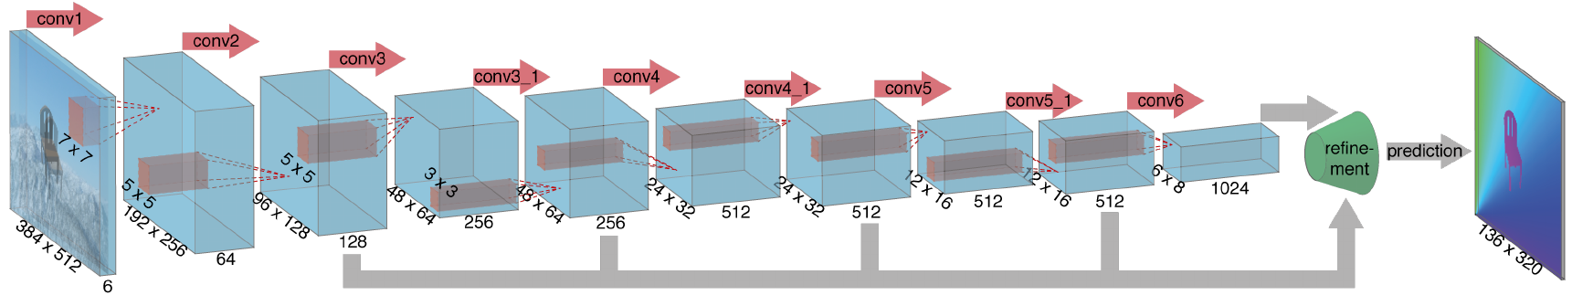
Flow Net
Predict the optical flow ( 2 maps: for x,y coordinates)
Take as input 2 images: process them with convolutional-deconvolutional model
FlowNet Simple: concatenate the 2 images at input
Let the network learn to process the two images to extract motion information

Slide 66
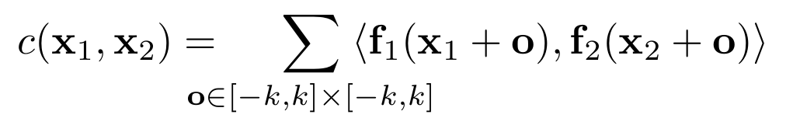
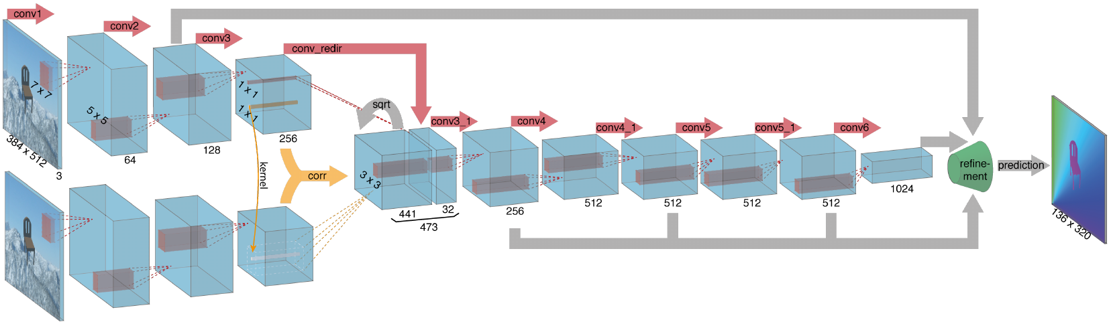
Flow Net-Correlations
Explicit design the network to do matching
Estimate correlations between patches in the first image and close patches in the second image
For every patch in the first image, compute correlations with the D^2 nearest patches from the second image
Keep all the resulted correlations as channels in a feature map
Dot product

Slide 67
DETECTION

Slide 68

Detection
Find every instance of certain objects in an image
Draw a tight box around every object

Slide 69

Faster - RCNN
Learn to predict a box for every object using a neural network
First learn to predict boxes of regions most probable to contain objects (region proposals)
S. Ren et al.[2015]: Faster r-cnn: Towards real-time object detection with region proposal networks

Slide 70
Faster - RCNN
Learn to predict a box for every object using a neural network
First learn to predict boxes of regions most probable to contain objects (region proposals)
For the most probable regions predict if it contains an object and refine the box
S. Ren et al.[2015]: Faster r-cnn: Towards real-time object detection with region proposal networks

Slide 71

Detection: R-CNN
Train a Network for classification
Run network on most probable regions (computed by other methods)
Problem:
SLOW
MANY redundant operations
Solution:
For every image compute features for the entire image with fully convolutional network
Predict region proposals from the same conv network

Slide 72

Detection: Faster - RCNN
Start with a convolutional network called backbone to extract features from the image
At each point in the resulted feature maps predict a set of box proposals using a network called Region Proposal Network
From the features corresponding the whole image extract features corresponding to the best proposals
Process the extracted box features with fully connected layers and predict the object class and the final box

Slide 73

Region Proposal Network (RPN)
From every 3x3 patch of features predict a box
3x3 patch has a sufficiently large receptive field to cover most objects
(228 pixels wide compared to 600 pixels of the input)
Predict the existence of boxes around k anchor boxes of different scales and aspect ratios
Fully convolutional network:
3x3 convolutional layer
1x1 conv layer for predicting objectness scores
1x1 conv layer for predicting box coordinates
S. Ren et al.[2015]: Faster r-cnn: Towards real-time object detection with region proposal networks

Slide 74










Region Proposal Network (RPN)
: classification loss
Negative loss likelihood
: regression loss
or loss
Smooth loss
: predicted objectness score
: predicted coordinates
: Ground Truth object existence in the region
: GT coordinates of the region

Slide 75

RoI Pooling
Select features corresponding to a region of interest (ROI)
Represent that region as a grid of fix size (eg. 3x3):
Each point in the grid is formed by max pooling a small region of features

Slide 76
Final box prediction
From the extracted ROI features predict the class of the objects and the final box coordinates
Predict C+1 values for the C classes and one for background
Predict a set of box coordinates for every class
Like in RPN combine classification loss and coordinate regresion loss
RPN and the backbone share the fully convolutional operations
The final classification is independent for every proposal (but the parameters are shared)
Other: SSD — Single Shot Detector

Slide 77
INSTANCE SEGMENTATION

Slide 78


Instance Segmentation
Q: Semantic Segmentation vs Instance Segmentation?
Semantic segmentation: pixels of a certain class
Instance segmentation: pixels of each individual instance separately
Image source: Pinheiro et al. [2016] and Farabet et al. [2013]

Slide 79

Mask R-CNN
Use an additional segmentation branch in Faster R-CNN
For each proposal given gy RPN estimate a segmentation mask

Slide 80

Mask R-CNN
After the RPN extract 7x7 patch features from every region of interest
Predict the final class and the box coordinates
Using fully convolutional network predict a segmentation mask corresponding to the object in the ROI

Slide 81

RoIPool vs RoIAlign:
Region of Interest (RoI): region in the input that we want to consider
For a given ROI (blue)
Extract features from the feature map (gray)
Features have lower resolution than the input
Each region in the input space does not have an exact correspondence at low resolution
(e.g. the desired region falls between the feature map grid)

Slide 82

RoIPool vs RoIAlign:
Region of Interest (RoI): region in the input that we want to consider
For a given ROI (blue)
Extract features from the feature map (gray)
Features have lower resolution than the input
Each region in the input space does not have an exact correspondence at low resolution
(e.g. the desired region falls between the feature map grid)
RoIPool:
Discretize the correct RoI to fit the low resolution
From the discrete region extract a 2x2 patch by mean / max pooling

Slide 83

RoIPool vs RoIAlign:
For a given RoI (blue)
Extract features from the feature map (gray)
RoIAlign:
Split the original RoI in NxN (e.g. 2x2) cells
For each cell consider 4 points at fixed locations
interpolate their value by considering the closest neighbours in the feature grid
and aggregate them by max-pool or average
By RoIAlign the extracted features are more aligned to the original object
The resulting segmentation would be more fine grained and more aligned to the object boundaries

Slide 84

Results

Slide 85

CLIP - multi-modal

Slide 86
Thank you!
(Next 3 courses: Transformers, ChatGPT, Stable Diffusion)
Be there!

Slide 87
References
A. Dosovitskiy, P. Fischer, E. Ilg, P. Hausser, C. Hazirbas,V. Golkov, P. Van Der Smagt, D. Cremers, and T. Brox.Flownet: Learning optical flow with convolutional networks. InProceedings of the IEEE international conference on computer vision, pages 2758–2766, 2015.
R. Girshick. Fast r-cnn. InProceedings of the IEEE international conference on computer vision, pages 1440–1448, 2015.
R. Girshick, J. Donahue, T. Darrell, and J. Malik. Rich feature hierarchies for accurate object detection and semantic segmentation. InProceedings of the IEEE conference on computer vision and pattern recognition, pages 580–587, 2014.
H. Noh, S. Hong, and B. Han. Learning deconvolution network for semantic segmentation. InProceedings of the IEEE International Conference on Computer Vision, pages 1520–1528, 2015.
T. Park, M.-Y. Liu, T.-C. Wang, and J.-Y. Zhu. Semantic image synthesis with spatially-adaptive normalization. In Proceedings of the IEEE Conference on Computer Vision and Pattern Recognition, 2019.
S. Ren, K. He, R. Girshick, and J. Sun. Faster r-cnn: Towards real-time object detection with region proposal networks. In Advances in neural information processing systems, pages 91–99,2015.

Slide 88
References
O. Ronneberger, P. Fischer, and T. Brox. U-net: Convolutional networks for biomedical image segmentation. In International Conference on Medical image computing and computer-assisted intervention, pages 234–241. Springer, 2015.
F. Yu and V. Koltun. Multi-scale context aggregation by dilated convolutions.arXiv preprint arXiv:1511.07122, 2015.
Van der Laak, Jeroen, Geert Litjens, and Francesco Ciompi. "Deep learning in histopathology: the path to the clinic." Nature medicine 27.5 (2021)

